Slide 1
Chapter 4 Relational Database Query Languages
4.1 SQL-feature of SQL, queries and sub-queries, join operation, set operations and other SQL constructs
4.2 DDL and DML queries in SQL
4.3 Stored Procedures
4.4 QBE

Slide 2
4.1 Introduction to SQL
SQL was developed in 1970’s in an IBM laboratory “San Jose Research Laboratory” (now the Amaden Research center).
SQL is derived from the SEQUEL one of the database language popular during 1970’s.
SQL established itself as the standard relational database language. Two standard organization (ANSI) and International standards organization (ISO) currently promote SQL standards to industry.
Structured Query Language is a special-purpose programming language designed for managing data held in a RDBMS.

Slide 3
Basic Term and Terminology
Query: It is a statement requesting the retrieval of information.
Query language: Language through which user request information from database. The two types of query language are:
Procedural language: User instructs the system to perform sequence of operation on the database to compete the desired result. Example: relational algebra
Non- procedural language: User describes the desired information without giving a specific procedure for obtaining that desired information. Examples: SQL

Slide 4
Basic Term and Terminology
Data-definition language (DDL).
The SQL DDL provides commands for defining relation schemas, deleting relations, and modifying relation schemas.
Data-manipulation language (DML).
The SQL DML provides the ability to query information from the database and to insert tuples into, delete tuples from, and modify tuples in the database.

Slide 5
Basic Term and Terminology
Integrity.
The SQL DDL includes commands for specifying integrity constraints that the data stored in the database must satisfy. Updates that violate integrity constraints are disallowed.
View definition.
The SQL DDL includes commands for defining views.
Transaction control.
SQL includes commands for specifying the beginning and ending of transactions.
Embedded SQL and dynamic SQL.
Embedded and dynamic SQL define how SQL statements can be embedded within general-purpose programming languages, such as C, C++, and Java.
Authorization.
The SQL DDL includes commands for specifying access rights to relations and views.

Slide 6
Query language Vs. Formal languages
The formal languages provides concise notation for representing query. But commercial database system requires more user friendly query language. This is a main reason for why we need query languages, even we have formal languages.
The formal languages form the basis for data manipulation language of DBMS only but DBMS/commercial DBMS also supports data definition capabilities as well as data manipulation capabilities.
SQL is a most popular and powerful query language. It can do much more than just query database. It can define structure of data, modify data in database and allow to specify security constraints.
SQL is a truly non procedural language. It has all features of relational algebra, relational calculus as well as its own powerful features.

Slide 7
4.2 Categories of SQL Commands
SQL commands can be roughly divided into three major categories with regard to their functionality.
Firstly, there are those used to create and maintain the database structure.
The second category includes those commands that manipulate the data in such structures.
And, thirdly there are those that control the use of the database.

Slide 8
4.2 Categories of SQL Commands
Types of commands
Data Definition Language(DDL)
Create and Maintain Database
Data Manipulation Language(DML)
Manipulate data in tables
Data Control Language(DCL)
Control usage of data
Transaction Control Language(TCL)
Control the transaction

Slide 9
4.2 Categories of SQL Commands
Data Definition Language(DDL)
Create : create database and tables
Alter : modify design of table in database
Drop : deletes database or a table in the database

Slide 10
4.2 Categories of SQL Commands
Data Manipulation Language(DML)
Insert : save data in tables
Select : retrieve data from tables
Update: modify data in tables
Delete : deletes data from tables

Slide 11
4.2 Categories of SQL Commands
Data Control Language(DCL)
Grant: Give privileges to user to access data
Revoke : Cancel the privileges given
Transaction Control Language(TCL)
Commit : Saves the changes made to database
Rollback : Undo changes to database from the current state database to last commit state

Slide 12
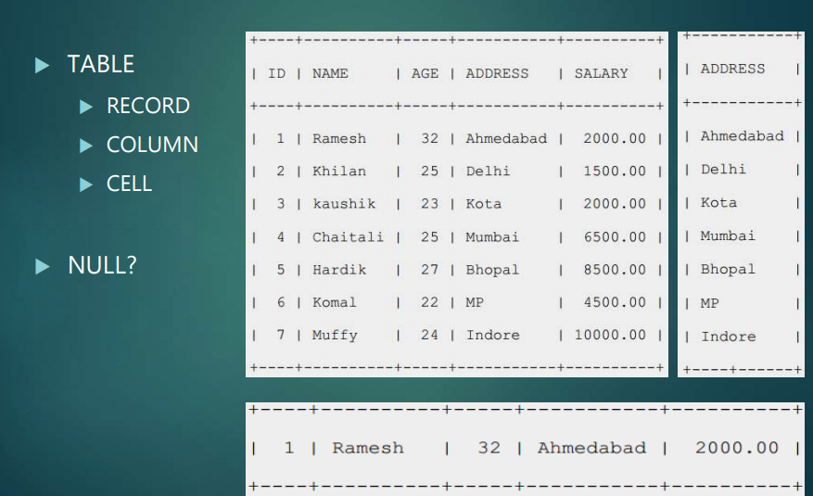
SQL RDBMS Concepts

Slide 13
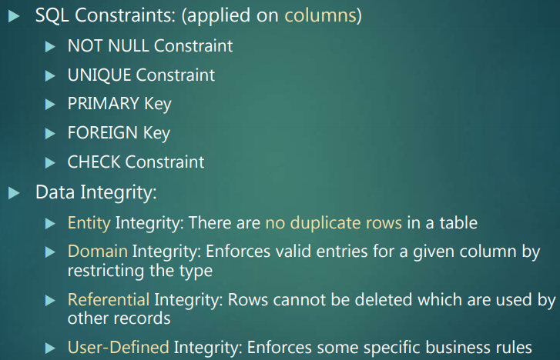
SQL RDBMS Concepts

Slide 14
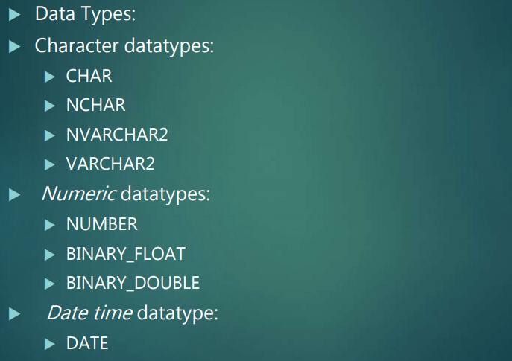
SQL RDBMS Concepts

Slide 15
This is the end of the lecture!
I hope you enjoyed it.
Thank You

